Slide 1
Lecture 14: Data Repairing

Slide 2
Today’s Agenda
Recap and Data Repairing
Constraint-based Data Repairing
Probabilistic Data Repairing

Slide 3
1. Recap and Data Repairing
Section 1

Slide 4
What is a Data Error?
Section 1

Slide 5
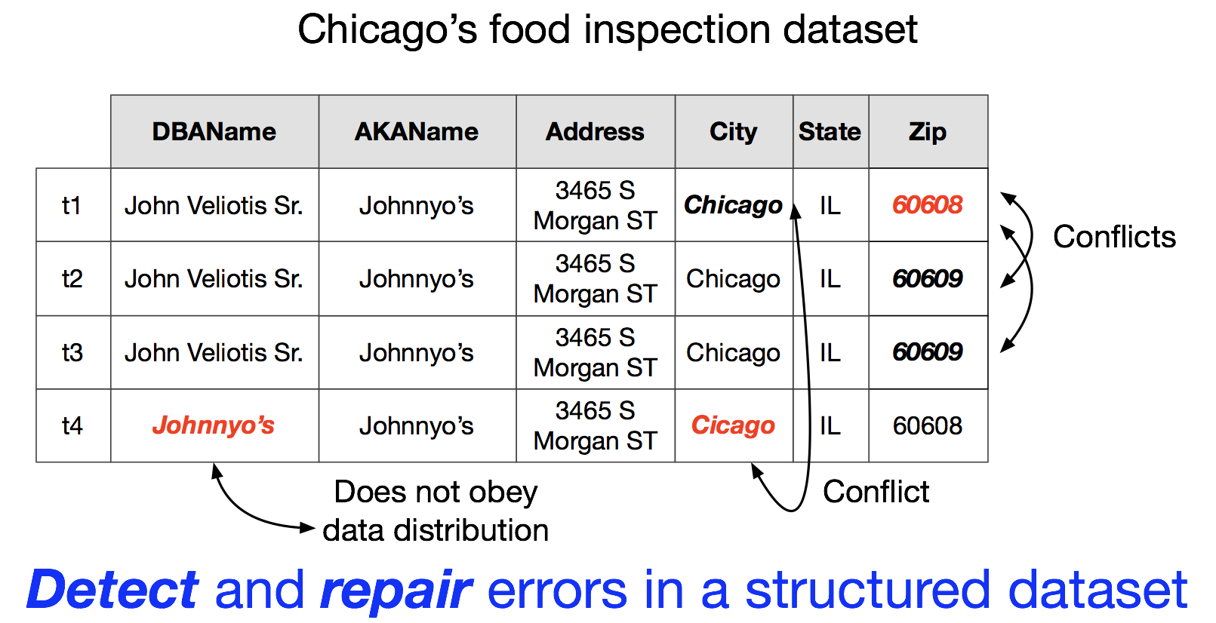
Example
Section 1

Slide 6
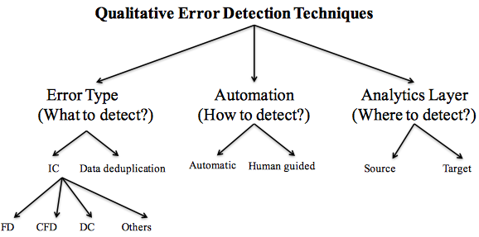
Error Detection Taxonomy
Section 1

Slide 7
Example
Section 1
No constraint violations but did we fix the errors?

Slide 8
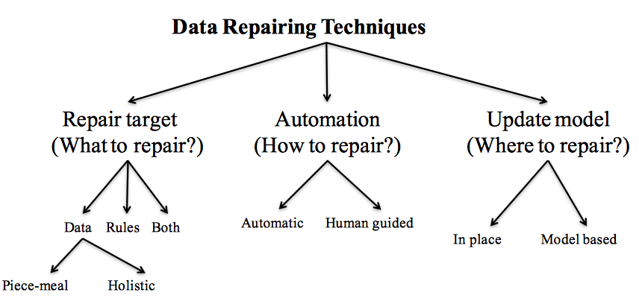
Data Repairing Taxonomy
Section 1

Slide 9
How to automate?
Section 1
Most automatic repairing techniques adopt the “minimality” of repairs principle
Repairing techniques in practice are manual and semi-automatic at best

Slide 10
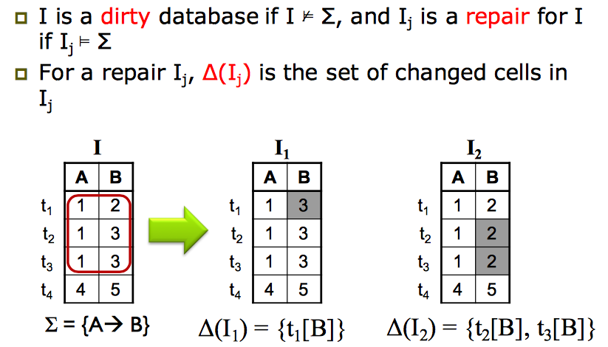
Data repairs by Value Update
Section 1

Slide 11
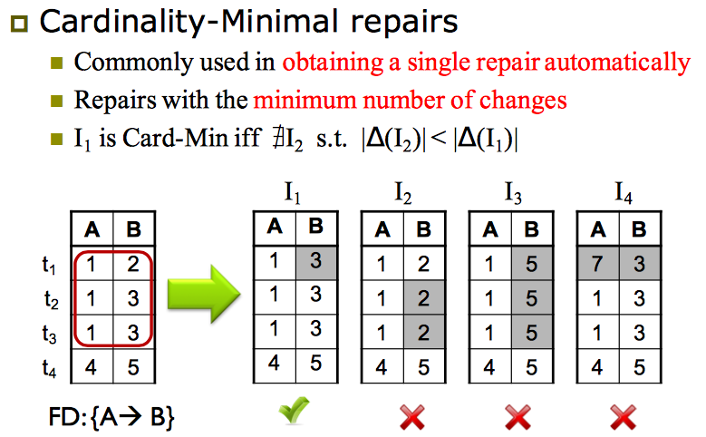
Data repairs by Value Updates
Section 1

Slide 12
2. Constraint-based Data Repairing
Section 2

Slide 13
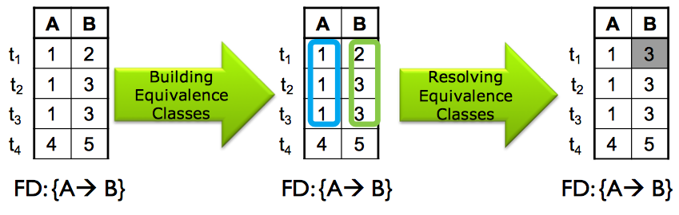
FD-based repairing
Section 2

Slide 14
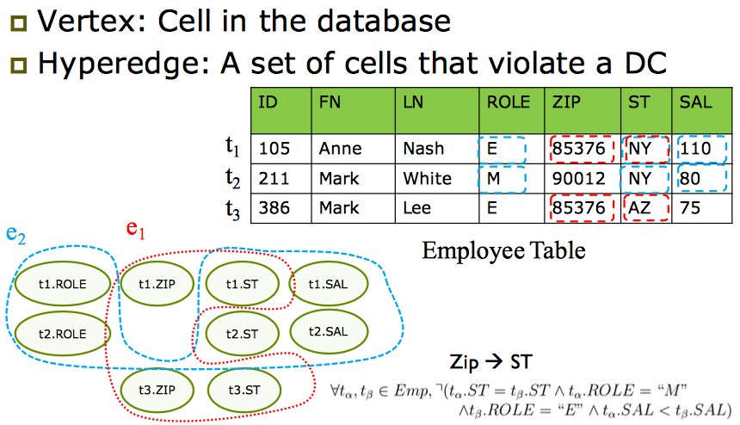
Holistic Constraint-based Repairing
Section 2

Slide 15
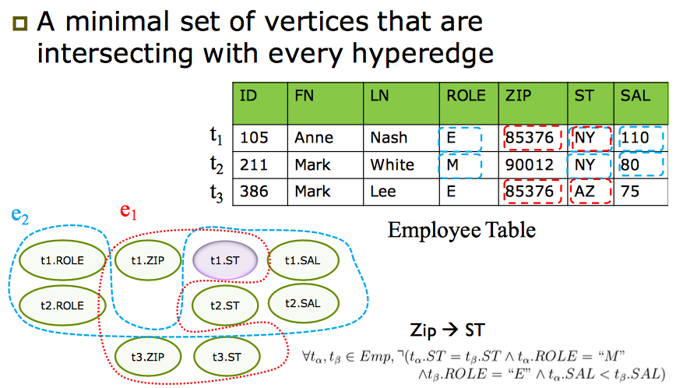
Step1: Minimal Vertex Cover
Section 2

Slide 16
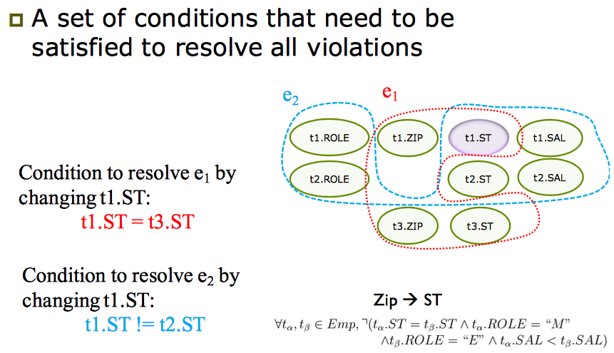
Step2: Collect Repair Requirements
Section 2

Slide 17
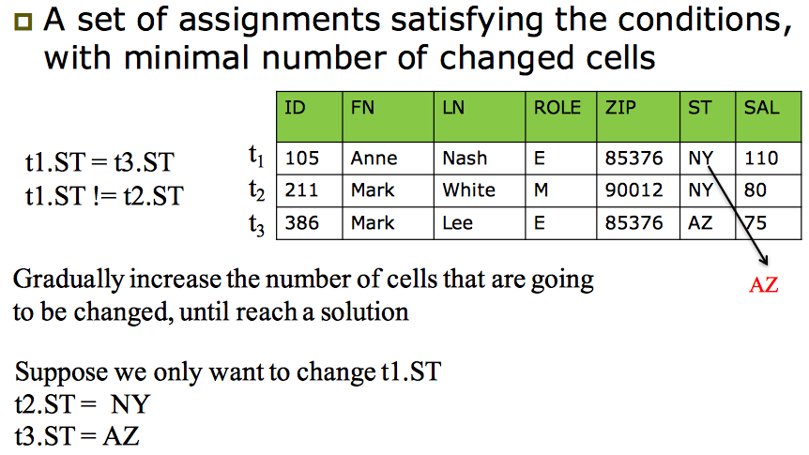
Step3: Get Updates
Section 2

Slide 18
3. Probabilistic Data Repairing
Section 3

Slide 19
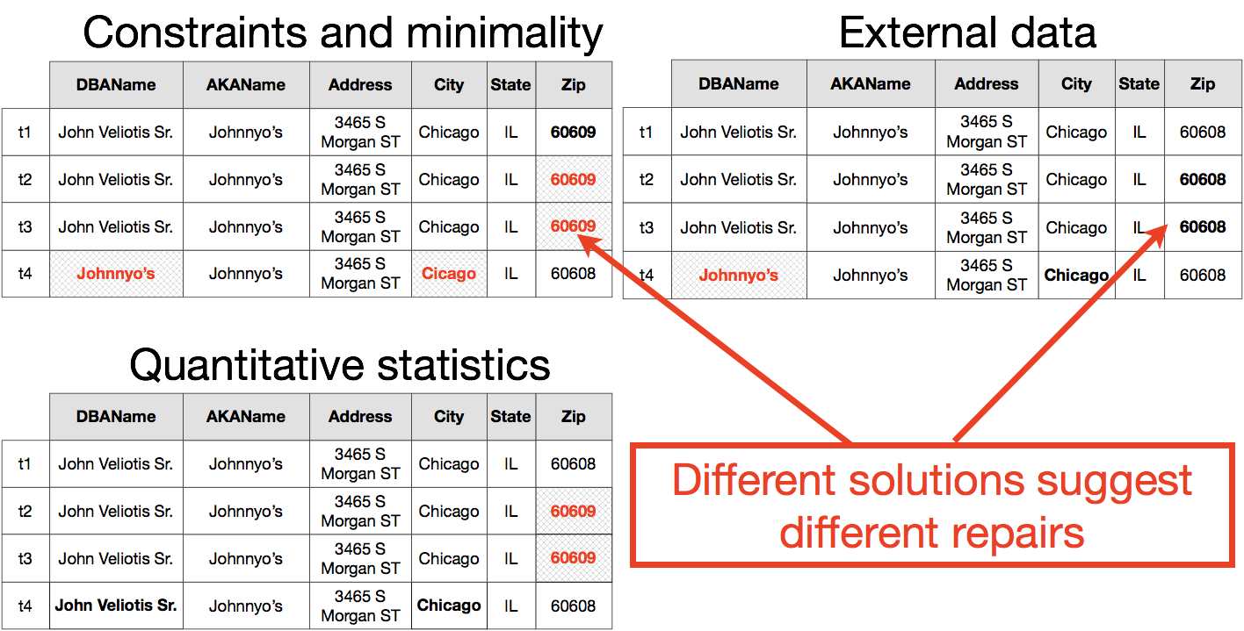
Lots of Possible Repairs
Section 3

Slide 20
Probabilistic Data Repairs
Section 3

Slide 21
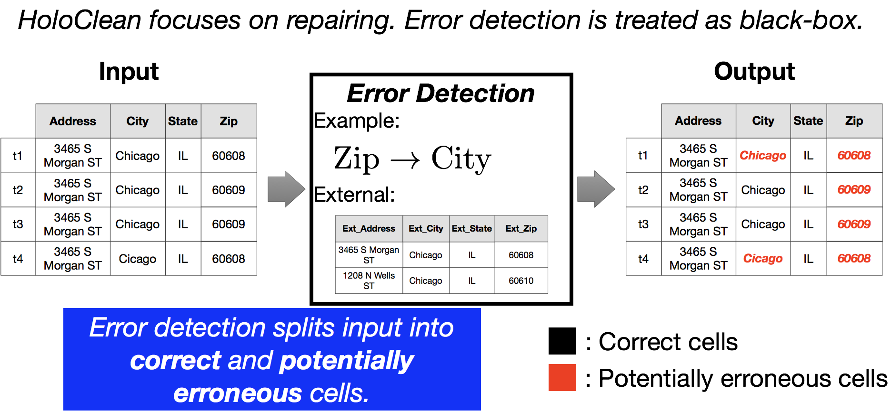
Error detection as a black box
Section 3

Slide 22
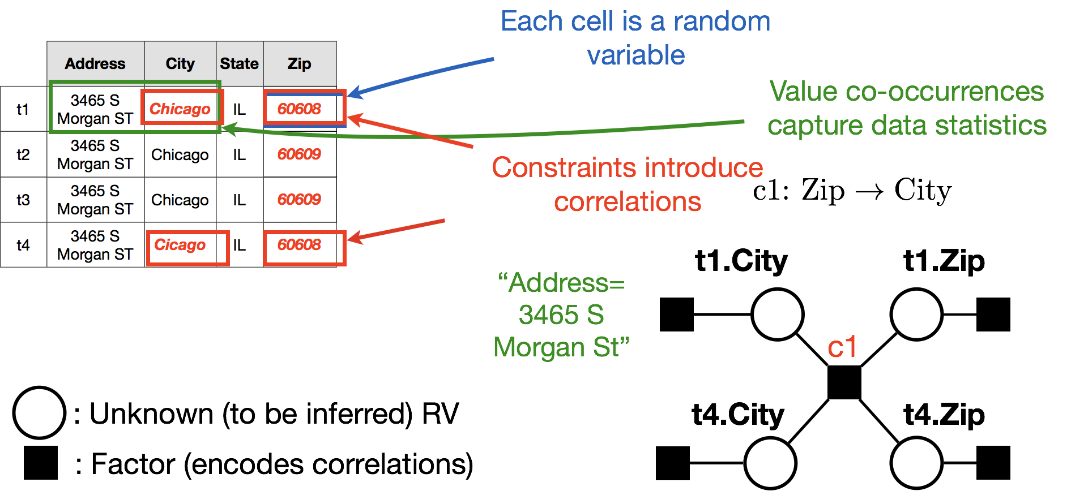
A model for data repairs
Section 3

Slide 23
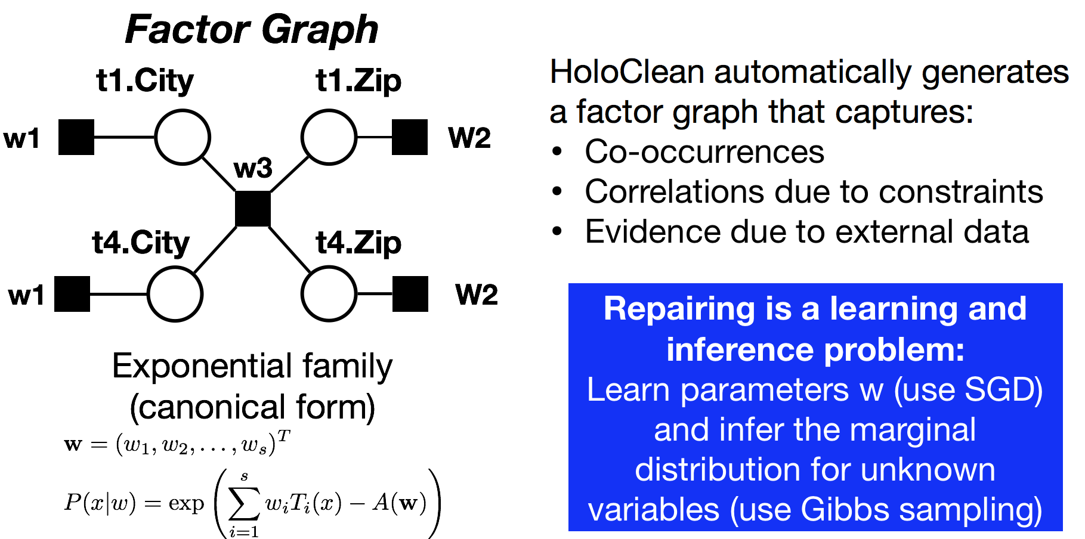
A model for data repairs
Section 3

Slide 24
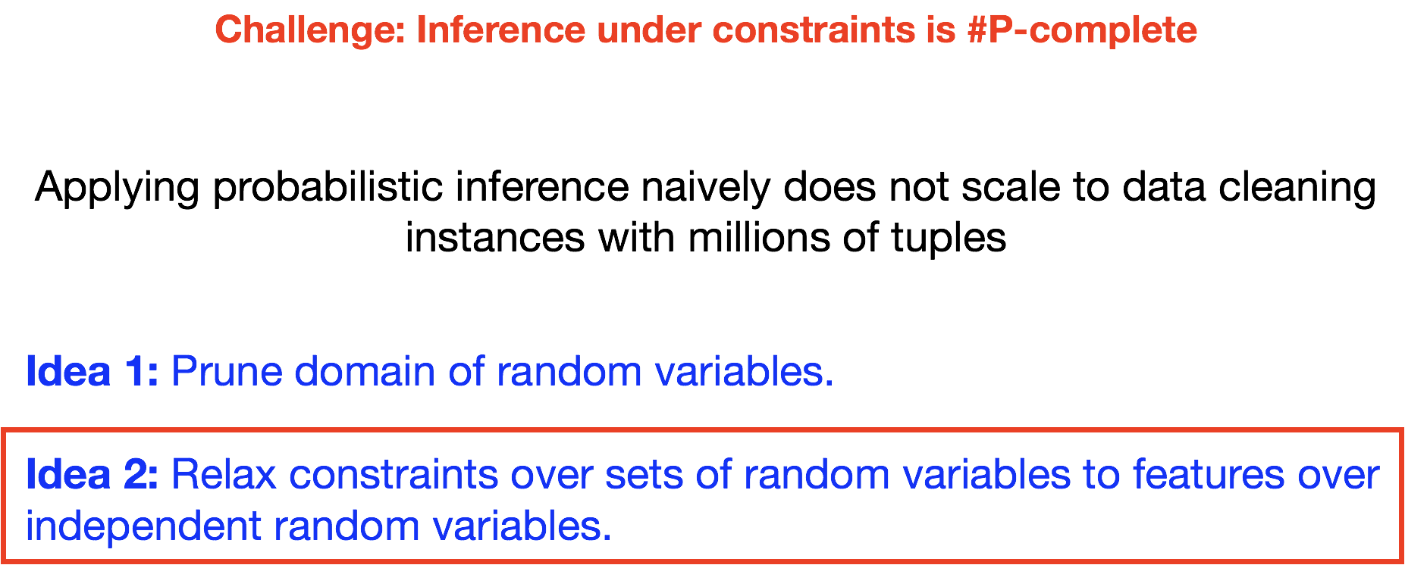
Scaling inference
Section 3

Slide 25
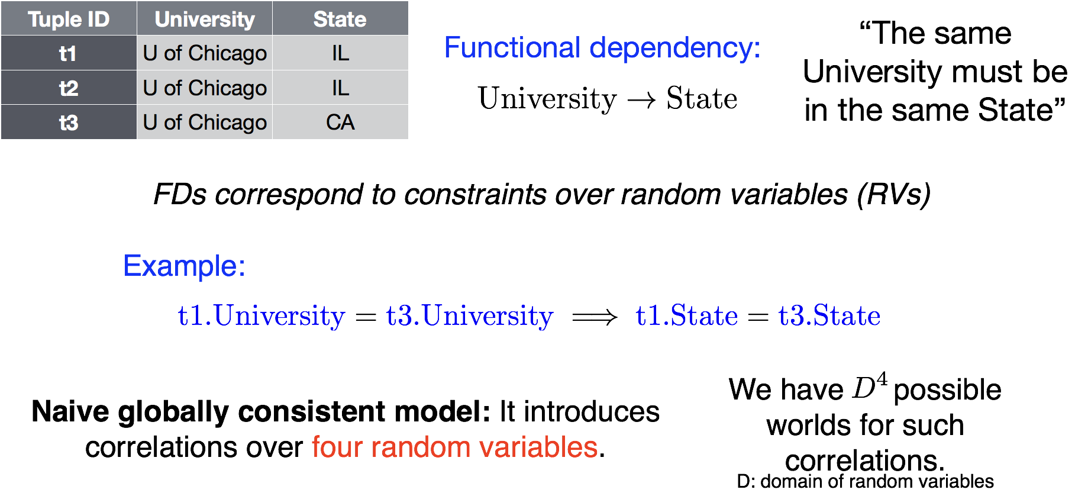
Relaxing Constraints
Section 3

Slide 26
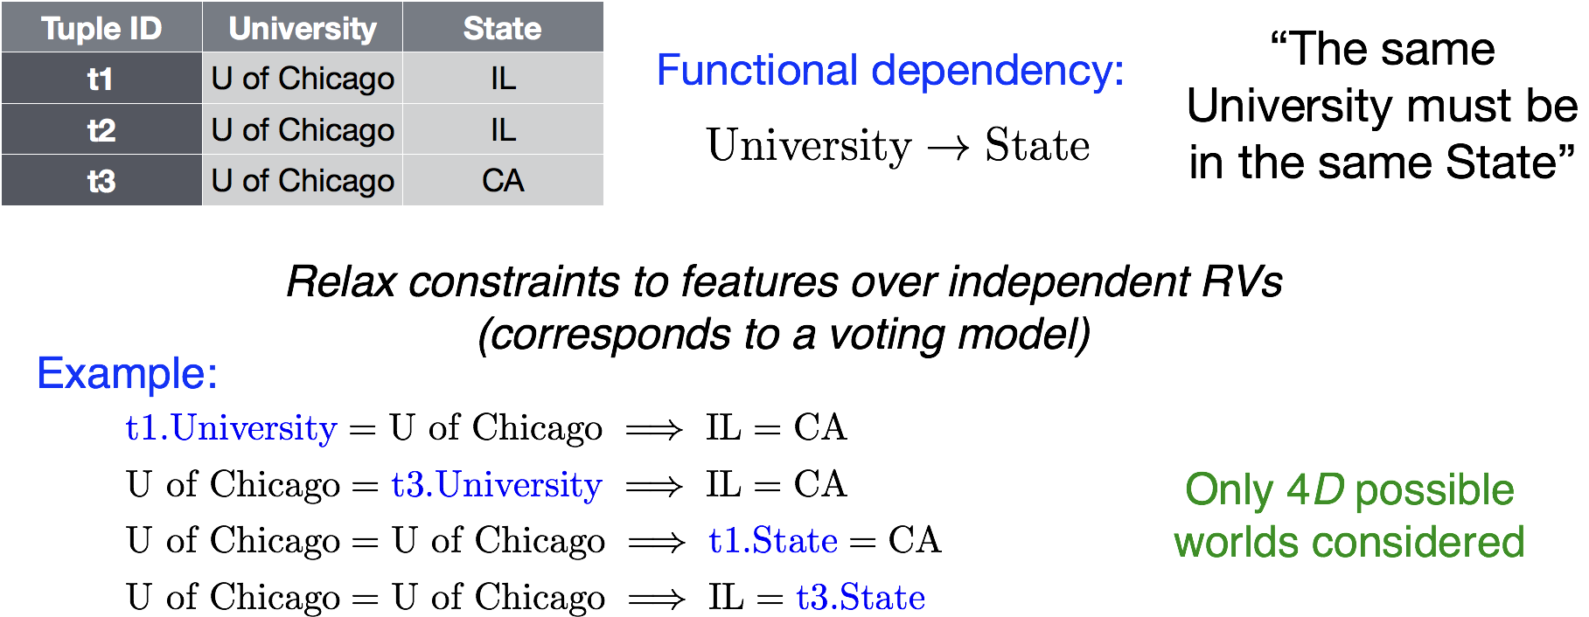
Relaxing Constraints
Section 3

Slide 27
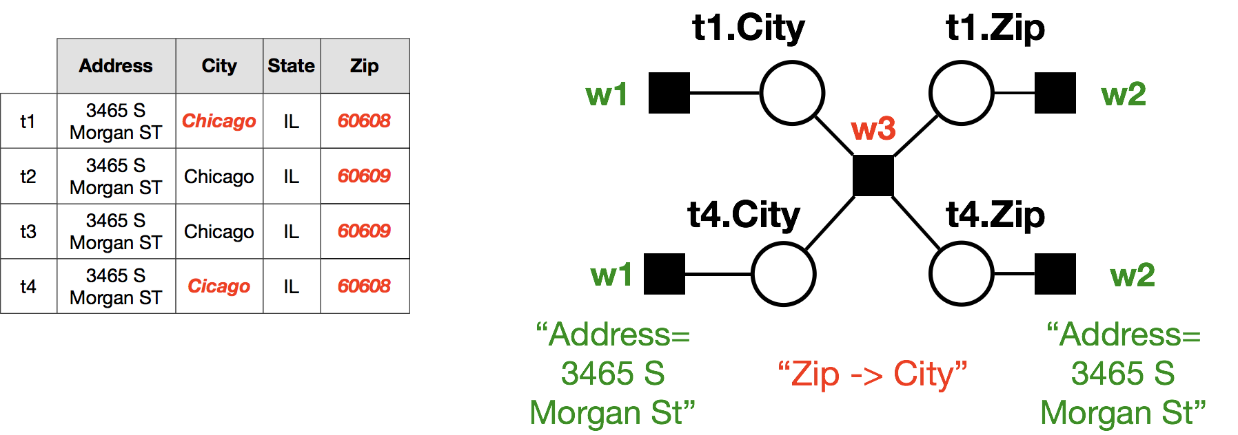
Relaxing Constraints
Section 3

Slide 28
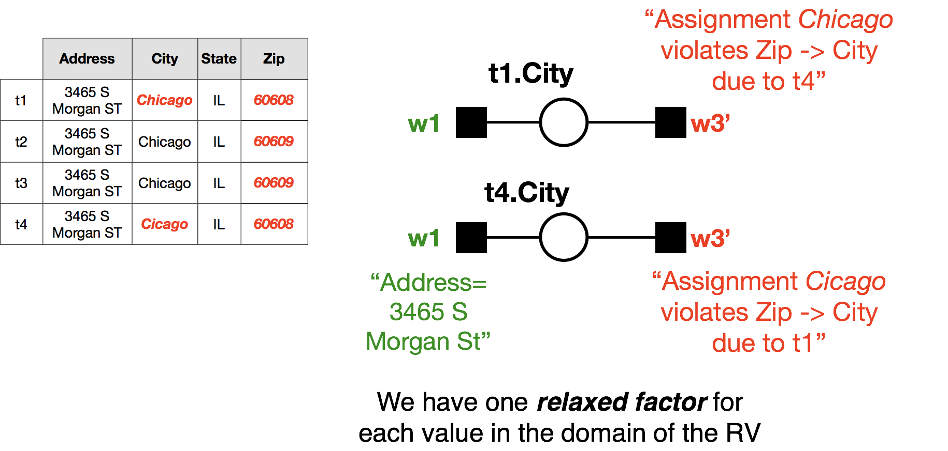
Relaxing Constraints
Section 3

Slide 29

Relaxing Constraints
Section 3

Slide 30
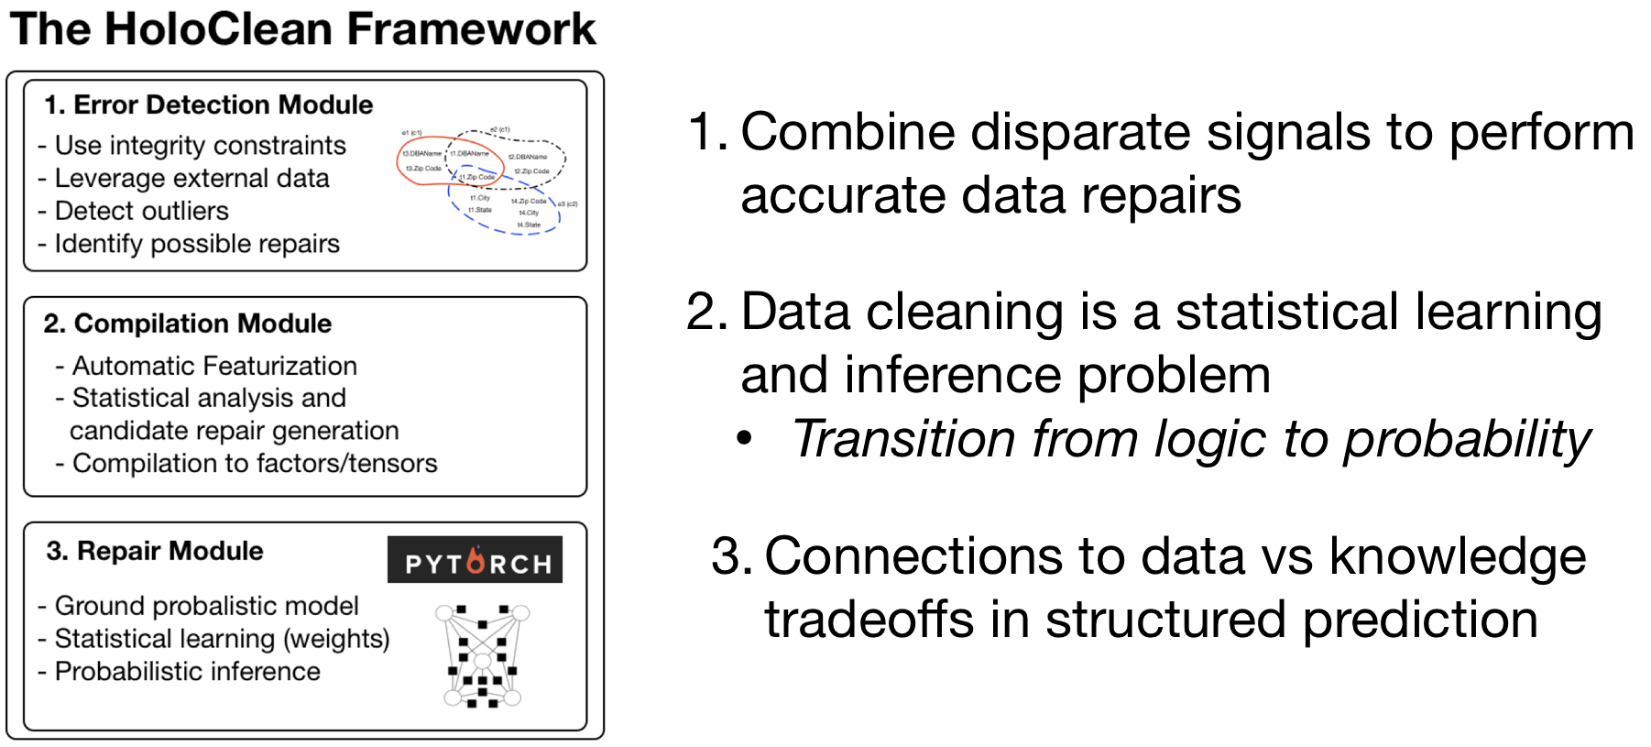
Data repairing as an ML problem
Section 3

